Slide 1

Computer Consultation Tutorial 1
Cairo University
Faculty of Engineering
Computer Engineering Department

Slide 2
Instructor & Drive
Eng. Ahmed Hashish
Ahmed.hashish98@eng.cu.edu.eg
Google Drive:
https://drive.google.com/drive/folders/192RgAGaST1axwr7hg0d4A2TA4SZiJgac?usp=sharing

Slide 3
Agenda
HTML Basics
Styling and CSS

Slide 4
Lesson(1) HTML Basics

Slide 5
What We Need?
Any text editor (like Notepad) or HTML editor
Browser

Slide 6
What is HTML?
HTML stands for Hyper Text Markup Language.
HTML is a language for describing web pages.
HTML is not a programming language, it is a markup language.
A markup language is a set of markup tags.
Notes:
The language that tells the browser what to put where???
HTML consists of a series of elements
HTML elements tell the browser how to display the content
HTML elements label pieces of content such as "this is a heading", "this is a paragraph", "this is a link", etc.
6

Slide 7
HTML Tags
HTML tags are keywords surrounded by angle brackets like <html>
HTML tags normally come in pairs like <b> and </b>
HTML tags are not case sensitive.
The first tag in a pair is the start tag, the second tag is the end tag

Slide 8
HTML Documents
HTML documents are also called web pages
The purpose of a web browser (such as Internet Explorer, Firefox, and Google Chrome) is to read HTML documents and display them as web pages.
The browser does not display the HTML tags, but uses the tags to interpret the content of the page:

Slide 9
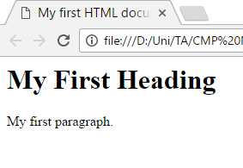
Example
<html>
<head>
<title>My first HTML document</title>
</head> <body> <h1>My First Heading</h1> <p>My first paragraph.</p> </body>
</html>
HTML Tags
Tag Content
Notes:
Body section holds all the contents that will appear in the webpage
Header part related to the name that will appear in the browser
9

Slide 10
Example Explained
The text between <html> and </html> describes the web page
The text between <body> and </body> is the visible page content
The text between <h1> and </h1> is displayed as a heading
The text between <p> and </p> is displayed as a paragraph

Slide 11
HTML Elements
HTML documents are defined by HTML elements.
An HTML element is everything from the start tag to the end tag.
Start Tag | Element Content | End Tag
<p> | This is a para.. | </p>
<a href="default.htm"> | Click Here | </a>

Slide 12
Nested HTML Elements
Most HTML elements can be nested
(can contain other HTML elements).
<html> <body> <p>My first paragraph.</p> </body>
</html>

Slide 13
HTML Attributes
HTML provide additional information about an element
Attributes are always specified in the start tag
Attributes come in name/value pairs like:
name=“value”
i.e
<a href="http://www.google.com">This is a link</a>
Notes:
<a> tag is for links
13

Slide 14
HTML Attributes - Cont.(1)
Attribute values should always be enclosed in quotes.
Double style quotes are the most common, but single style quotes are also allowed.
Note: In some rare situations, when the attribute value itself contains quotes, it is necessary to use single quotes: name='John "ShotGun" Nelson'

Slide 15
HTML Headings
Use HTML headings for headings only. Don't use headings to make text BIG or bold.
Search engines use your headings to index the structure and content of your web pages.
Since users may skim your pages by its headings, it is important to use headings to show the document structure.

Slide 16
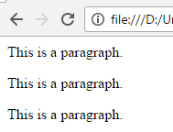
HTML Paragraphs
HTML paragraphs are defined with the <p> tag.
<html>
<body>
<p>This is a paragraph.</p>
<p>This is a paragraph.</p>
<p>This is a paragraph.</p>
</body>
</html>
Notes:
<p> create double line space between paragraphs
16

Slide 17
HTML Content Spaces
With HTML, you cannot change the output by adding extra spaces or extra lines in your HTML code.
The browser will remove extra spaces and extra lines when the page is displayed. Any number of lines count as one line, and any number of spaces count as one space.
Notes:
Space code: &nbsp;
17

Slide 18

HTML Line Breaks
Use the <br > tag if you want a new line without starting a new paragraph:
<html>
<body>
<p>This is <br /> a para <br /> graph with line breaks</p>
</body>
</html>

Slide 19
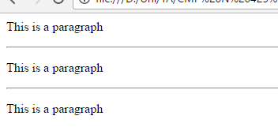
HTML Lines
The <hr /> tag creates a horizontal line in an HTML page.
The hr element can be used to separate content:
<html>
<body>
<p>This is a paragraph</p>
<hr />
<p>This is a paragraph</p>
<hr />
<p>This is a paragraph</p>
</body>
</html>
Notes:
<hr> horizontal rule tag
Instead of writing <hr></hr> we write <hr/> cause it is an empty tag
19

Slide 20
HTML Comments
Comments can be inserted into the HTML code to make it more readable.
Comments are ignored by the browser and are not displayed.
<html>
<body>
<!- - This comment will not be displayed - ->
<p>This is a regular paragraph</p>
</body>
</html>

Slide 21
HTML Links
HTML hyper links are defined with the <a> tag.
<html>
<body>
<a href="http://www.google.com">
This is a link</a>
</body>
</html>
Attribute
Notes:
21

Slide 22
HTML Links - The target Attribute
The target attribute specifies where to open the linked document.
The example below will open the linked document in a new browser window:
<html>
<body>
<a href="http://www.w3schools.com/" target="_blank">Visit W3Schools.com!</a>
<p>If you set the target attribute to "_blank", the link will open in a new browser window.</p>
</body>
</html>
Notes:
22

Slide 23
HTML Links - The target Attribute
Target Value | Description
_blank | Opens the linked document in a new window or tab
_self | Opens the linked document in the same frame as it was clicked (this is default)
_parent | Opens the linked document in the parent frame
_top | Opens the linked document in the full body of the window
framename | Opens the linked document in a named frame

Slide 24
HTML Links - The name Attribute
The name attribute is used to create a bookmark inside an HTML document.
Bookmarks are not displayed in any special way. They are invisible to the reader.
<html>
<body>
<p>
<a href="#C4">See also Chapter 4.</a>
</p>
<h2>Chapter 1</h2>
<p>This chapter explains ba bla bla</p>
<h2><a name="C4">Chapter 4</a></h2>
<p>This chapter explains ba bla bla</p>
</body>
</html>

Slide 25
HTML Links – Sending Email
<html>
<body>
<p>
This is an email link:
<a href="mailto:someone@example.com?Subject=Hello again">
Send Mail</a>
</p>
</body>
</html>

Slide 26
HTML Images
HTML Images are defined with the <img> tag.
<html>
<body>
<img src=“image1.jpg" width="104" height="142“ />
</body>
</html>
Note: The location and the dimensions of the image are provided as attributes.

Slide 27
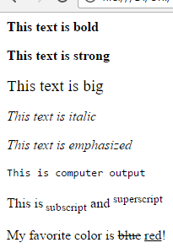
HTML Text Formatting
<html>
<body>
<p><b>This text is bold</b></p>
<p><strong>This text is strong</strong></p>
<p><big>This text is big</big></p>
<p><i>This text is italic</i></p>
<p><em>This text is emphasized</em></p>
<p><code>This is computer output</code></p>
<p>This is<sub> subscript</sub> and <sup>superscript</sup></p>
<p>My favorite color is <del>blue</del> <ins>red</ins>!</p>
</body>
</html>
Notes:
<sub> for sub script, and <sup> super script
<code> change the format of the text to seem like computer code
<pre> is preserved tag where all spaces and enters are preserved in the paragraph
<strong> or <em> means that you want the text to be rendered in a way that the user understands as "important". Today, all major browsers render strong as bold and em as italics and will be showed as it written
27

Slide 28
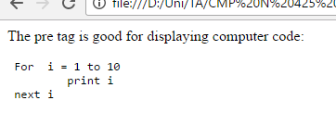
HTML Pre Element
Text in a pre element is displayed in a fixed-width font (usually Courier),
and it preserves both spaces and line breaks.
<html>
<body>
<p>The pre tag is good for displaying computer code:</p>
<pre>
For i = 1 to 10
print i
next i
</pre>
</body>
</html>

Slide 29
HTML Abbreviations and Acronyms
<html>
<body>
<p>The <abbr title="World Health Organization">WHO</abbr> was founded in 1948.</p>
<p>Can I get this <acronym title="as soon as possible">ASAP</acronym>?</p>
<p>The title attribute is used to show the spelled-out version when holding the mouse pointer over the acronym or abbreviation.</p>
</body>
</html>
Notes:
The <acronym> tag is not supported in HTML5. Use the <abbr> tag instead.
Abbreviation: An abbreviation is a shortened form of a word or phrase. It is typically created by taking the initial letters of each word in the phrase and combining them together. For example, "Mr." for "Mister" or "etc." for "et cetera." Abbreviations are pronounced by saying each letter individually or by pronouncing them as a single word, depending on the abbreviation.
Acronym: An acronym is also a shortened form of a word or phrase, but it is specifically created by taking the initial letters of each word and forming a new word that can be pronounced as a word itself. Unlike abbreviations, acronyms are pronounced as a complete word. For example, "NASA" for "National Aeronautics and Space Administration" or "UNESCO" for "United Nations Educational, Scientific and Cultural Organization."
29

Slide 30
HTML Tables
Tables are defined with the <table> tag.
A table is divided into rows (with the <tr> tag)
Each row is divided into data cells (with the <td> tag). td stands for "table data," and holds the content of a data cell.
A <td> tag can contain text, links, images, lists, forms, other tables, etc.

Slide 31
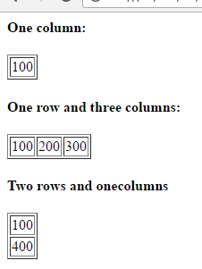
HTML Tables-Cont.(1)
<html>
<body>
<h4>One column:</h4>
<table border="1">
<tr>
<td>100</td>
</tr>
</table>
<h4>One row and three columns:</h4>
<table border="1">
<tr>
<td>100</td>
<td>200</td>
<td>300</td>
</tr>
</table>
<h4>Two rows and one column </h4>
<table border="1">
<tr>
<td>100</td>
</tr>
<tr>
<td>400</td>
</tr>
</table>
</body>
</html>

Slide 32
HTML Tables – The Border Attribute
To display a table with borders.
If you do not specify a border attribute, the table will be displayed without borders.
Notes:
<table border=“1” cellspacing=“5”> to specify the cells’ space between each other and to make table appeared with borders
32

Slide 33
HTML Table Headers
Header information in a table are defined with the <th> tag.
The text in a th element will be bold and centered.
<tr> <th>Header 1</th> <th>Header 2</th> </tr>
Header 1 | Header 2

Slide 34
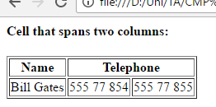
Colspan
Table cells that span more than one column
<html>
<body>
<h4>Cell that spans two columns:</h4>
<table border="1">
<tr>
<th>Name</th>
<th colspan="2">Telephone</th>
</tr>
<tr>
<td>Bill Gates</td>
<td>555 77 854</td>
<td>555 77 855</td>
</tr>
</table>
</body>
</html>

Slide 35
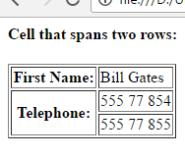
Rowspan
Table cells that span more than one row
<html>
<body>
<h4>Cell that spans two rows:</h4>
<table border="1">
<tr>
<th>First Name:</th>
<td>Bill Gates</td>
</tr>
<tr>
<th rowspan="2">Telephone:</th>
<td>555 77 854</td>
</tr>
<tr>
<td>555 77 855</td>
</tr>
</table></body></html>

Slide 36
HTML Table thead, tfoot, and a tbody element
<thead>Groups the header content in a table
<tbody>Groups the body content in a table
<tfoot>Groups the footer content in a table

Slide 37
HTML Lists
Most common Html Lists are:
Ordered List:
The first list item
The second list item
Unordered List:
List item
List item

Slide 38
HTML Lists – Cont.(1)
Definition List:
Is a list of items, with a description of each item.
Coffee
- black hot drink
Milk
- white cold drink

Slide 39
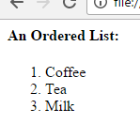
Example – Ordered List
<Ol > ordered list
<li> list item
<html>
<body>
<h4>An Ordered List:</h4>
<ol>
<li>Coffee</li>
<li>Tea</li>
<li>Milk</li>
</ol>
</body>
</html>

Slide 40
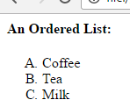
Example – Ordered List
(type attribute)
type -> A,a,I,i
<html>
<body>
<h4>An Ordered List:</h4>
<ol type="A">
<li>Coffee</li>
<li>Tea</li>
<li>Milk</li>
</ol>
</body>
</html>

Slide 41
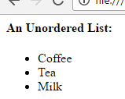
Example – Unordered List
<ul > unordered list
<li> list item
<html>
<body>
<h4>An Unordered List:</h4>
<ul>
<li>Coffee</li>
<li>Tea</li>
<li>Milk</li>
</ul>
</body>
</html>

Slide 42
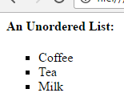
Example – Unordered List (type attribute)
type -> disc , circle, square
<html>
<body>
<h4>An Unordered List:</h4>
<ul type="square">
<li>Coffee</li>
<li>Tea</li>
<li>Milk</li>
</ul>
</body>
</html>

Slide 43
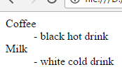
Example – Definition List
<dl > definition list
<dt> define an item
<dd> define a description of an item
<html>
<body>
<dl>
<dt>Coffee</dt>
<dd>- black hot drink</dd>
<dt>Milk</dt>
<dd>- white cold drink</dd>
</dl>
</body>
</html>

Slide 44
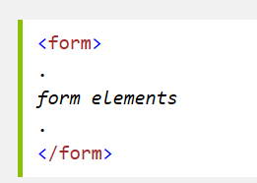
HTML Forms
HTML forms are used to collect user input.
The <form> element defines an HTML form:
HTML forms contain form elements: Form elements are different types of input elements

Slide 45
HTML Forms: The <input> Element
The <input> element has many variations, depending on the type attribute.
An input element can be of type:
text field,
checkbox,
password,
radio button,
submit button, and more.

Slide 46

The Input Element - Text Fields
<input type="text" />
<html> <body>
<form> First name: <input type="text" name="firstname"/><br/> Last name: <input type="text" name="lastname" /> </form> </body>
</html>
Notes:
The name attribute is used to reference elements in a JavaScript, or to reference form data after a form is submitted.
[Note]: Only form elements with a name attribute will have their values passed when submitting a form.

Slide 47

The Input Element-Password Field
<input type=“password" />
<html> <body>
<form> Password: <input type="password" name="pwd" /> </form> </body>
</html>
******

Slide 48

The Input Element- Radio Buttons
<input type=“radio" />
<html> <body>
<form> <input type="radio" name=“gender ” checked/> Male<br /> <input type="radio” name=“gender” /> Female </form> </body>
</html>

Slide 49

The Input Element- Submit Button
<input type=“submit" />
<html> <body>
<form name="input" action="html_form_action.asp" method="get"> Username: <input type="text" name="user" /> <input type="submit" value="Submit" /> </form>
</body>
</html>
Notes:
actionURLSpecifies where to send the form-data when a form is submitted methodget, post Specifies the HTTP method to use when sending form-data The form-data can be sent as URL variables (with method="get") or as HTTP post transaction (with method="post").
Notes on GET:
Appends form-data into the URL in name/value pairs
The length of a URL is limited (about 3000 characters)
Never use GET to send sensitive data! (will be visible in the URL)
Useful for form submissions where a user want to bookmark the result
GET is better for non-secure data, like query strings in Google
GET: The GET method is used to retrieve data from a server. It requests a representation of a specific resource, but it should not have any other effect on the server's data.
Notes on POST:
Appends form-data inside the body of the HTTP request (data is not shown is in URL)
Has no size limitations
Form submissions with POST cannot be bookmarked
POST: The POST method is used to submit data to be processed by the server. It typically results in a change in the server's state, such as creating a new resource or updating existing data.

Slide 50
The Input Element- Submit Button – 1/2
<input type="submit“ method=“Post”> defines a button for submitting a form to a form-handler.
The form-handler is typically a server page with a script for processing input data.
The form-handler is specified in the form's action attribute.
If the action attribute is omitted, the action is set to the current page.

Slide 51
The Input Element- Submit Button – 2/2
The method attribute specifies the HTTP method (GET or POST) to be used when submitting the forms:
Get:
the default method.
If the form submission is passive (like a search engine query), and without sensitive information.
When you use GET, the form data will be visible in the page address
Post:
If the form is updating data, or includes sensitive information (password).
POST offers better security because the submitted data is not visible in the page address.

Slide 52
The Input Element- Submit Button
Take Care
To be submitted correctly, each input field must have a name attribute

Slide 53
The <select> Element (Drop-Down List)
<html>
<body>
<form action="">
<select name="cars">
<option value="volvo">Volvo</option>
<option value="saab">Saab</option>
<option value="fiat">Fiat</option>
<option value="audi" selected>Audi</option>
</select>
</form>
</body>
</html>
The <option> elements defines the options to select.
The list will normally show the first item as selected.
You can add a selected attribute to define a predefined option.

Slide 54
The <button> Element
<html>
<body>
<button type="button" onclick="alert('Hello World!')">
Click Me!</button>
</body>
</html>

Slide 55
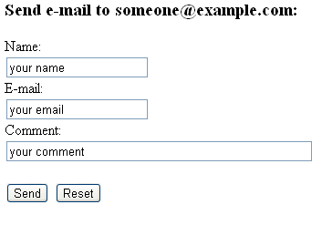
Send Email From a Form
<h3>Send e-mail to someone@example.com:</h3>
<form action="MAILTO:someone@example.com" method="post" enctype="text/plain">
Name:<br />
<input type="text" name="name" value="your name" /><br />
E-mail:<br />
<input type="text" name="mail" value="your email" /><br />
Comment:<br />
<input type="text" name="comment" value="your comment" size="50" />
<br /><br />
<input type="submit" value="Send">
<input type="reset" value="Reset">
</form>

Slide 56
Send Email From a Form-Comments
The size attribute specifies the size (in characters) for the input field.
enctype=“text/plain” 🡪 See other types
The enctype attribute can be used only if method="post".
Spaces are converted to "+" symbols, but no special characters are encoded

Slide 57
HTML Frames
HTML frames are used to divide your browser window into multiple sections where each section can load a separate HTML document.
A collection of frames in the browser window is known as a frameset.
The window is divided into frames in a similar way the tables are organized: into rows and columns.

Slide 58
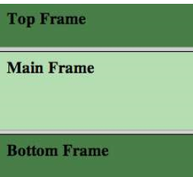
HTML Frames-Horizontal Frames
<html>
<frameset rows=“10%,80%,10%">
<frame src="frame_a.htm" />
<frame src="frame_b.htm" />
<frame src="frame_c.htm" />
</frameset>
</html>

Slide 59
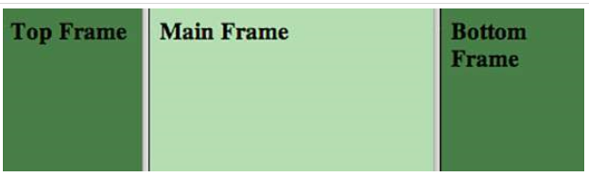
HTML Frames-Vertical Frames
<html>
<frameset cols="25%,50%,25%">
<frame src="frame_a.htm" />
<frame src="frame_b.htm" />
<frame src="frame_c.htm" />
</frameset>
</html>

Slide 60
HTML Frames-Comments
You can specify the width of each column/ height of each row in one of four ways:
Absolute values in pixels: cols="100, 500,100".
A percentage of the browser window: cols="10%, 80%,10%".
Using a wildcard symbol: cols="10%, *,10%".
As relative widths of the browser window: cols="3*,2*,1*".
🡪 Here the window is divided into sixths: the first column takes up half of the window, the second takes one third, and the third takes one sixth.

Slide 61
HTML Frames-Disadvantages
There are few drawbacks with using frames, so it's never recommended to use frames in your webpages :
Some smaller devices cannot cope with frames often because their screen is not big enough to be divided up.
Sometimes your page will be displayed differently on different computers due to different screen resolution.
The browser's back button might not work as the user hopes.
There are still few browsers that do not support frame technology.

Slide 62
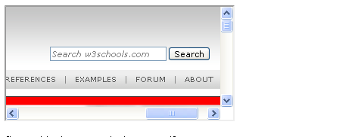
Inline Frames
An iframe is used to display a web page within a web page.
<html>
<body>
<iframe src=" frame_a.htm "></iframe>
</body>
</html>
Notes:
The height and width attributes are used to specify the height and width of the iframe. <iframe src="demo_iframe.htm" width="200" height="200"></iframe>
The attribute values are specified in pixels by default, but they can also be in percent (like "80%").
The frameborder attribute specifies whether or not to display a border around the iframe.
Set the attribute value to "0" to remove the border:
<iframe src="demo_iframe.htm" frameborder="0"></iframe>

Slide 63
HTML Meta Element
Metadata is data (information) about web page .
The <meta> tag provides metadata about the HTML document. Metadata will not be displayed on the page, but will be machine parse able.
Meta elements are typically used to specify page description, keywords, author of the document, last modified, and other metadata.
The metadata can be used by browsers (how to display content or reload page), search engines (keywords), or other web services.

Slide 64
The HTML Meta Element
The following meta element defines a description and a keywords of a page:
<head>
<meta name="description" content="Free Web tutorials on HTML, CSS, XML" />
<meta name="keywords" content="HTML, CSS, XML" />
</head>

Slide 65
The HTML meta Element Redirect to a new web address
<html>
<head>
<meta http-equiv="Refresh" content="5;url=http://www.google.com" />
</head>
<body>
<h1>Sorry! We have moved!</h1>
<h2>The new URL is:
<a href="http://www.google.com">http://www.google.com</a>
</h2>
<p>You will be redirected to the new address in five seconds.</p>
</body>
</html>

Slide 66
Lesson(2) CSS & STYLING

Slide 67
Cascading Style Sheets
Styles define how to display HTML elements
Styles were added to HTML 4.0 to solve the problem where fonts , color… information were added to every single page, became a long and expensive process.
External style sheets enable you to change the appearance and layout of all the pages in a Web site, just by editing one single file!
External Style Sheets are stored in CSS files.

Slide 68
Cascading Style Sheets
Styling can be added to HTML elements in 3 ways:
Inline - using a style attribute in HTML elements
Internal - using a <style> element in the HTML <head> section
External - using one or more external CSS files

Slide 69
CSS Syntax
The element/selector is an HTML element name.
The property is a CSS property.
The value is a CSS value.
Multiple styles are separated with semicolon.

Slide 70
Inline Styling (Inline CSS)
Inline styling is useful for applying a unique style to a single HTML element.
Inline styling uses the style attribute.
This inline styling changes the text color of a single heading:

Slide 71
HTML Styles
The purpose of the style attribute is:
To provide a common way to style all HTML elements.
<html>
<body style="background-color:PowderBlue;">
<h1 style="text-align:center">This is a heading</h1>
<p style="font-family:verdana;color:red">This text is in Verdana and red</p>
<p style="font-family:times;color:green">This text is in Times and green</p>
<p style="font-size:30px">This text is 30 pixels high</p>
<p style="font-family:arial;color:red;font-size:40px;">A paragraph.</p>
<p style="background-color:green">This is a paragraph.</p>
</body>
</html>

Slide 72
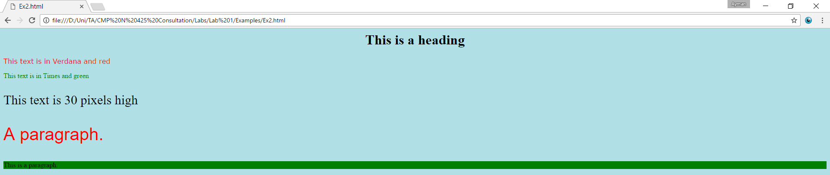
HTML Styles

Slide 73
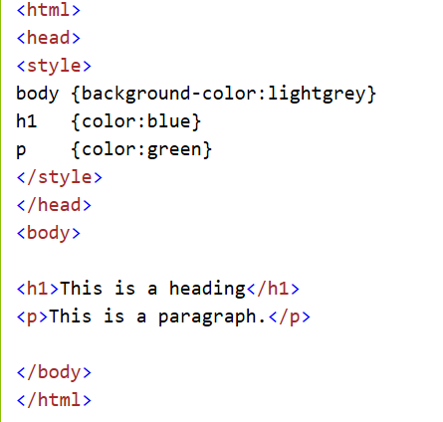
Internal Styling (Internal CSS)
An internal style sheet can be used to define a common style for all HTML elements on a page.
Internal styling is defined in the <head> section of an HTML page, using a <style> element:

Slide 74
External Styling (External CSS)
External style sheet are ideal when the style is applied to many pages.
With external style sheets, you can change the look of an entire web site by changing one file.
External styles are defined in an external CSS file, and then linked to in the <head> section of an HTML page

Slide 75
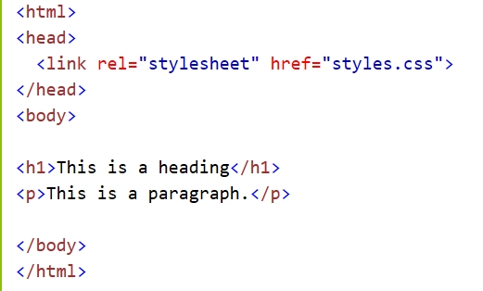
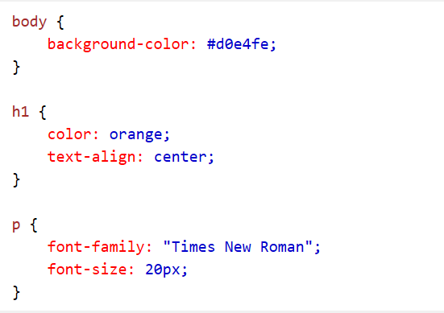
External Styling (External CSS)
Styles.css
Notes:
rel=Required. Specifies the relationship between the current document and the linked document

Slide 76
CSS Comments
/*This is a comment*/
p {
color: red;
text-align: center;
}

Slide 77


The id Attribute
To define a special style for one special element, first add an id attribute to the element:
then define a different style for the (identified) element:

Slide 78
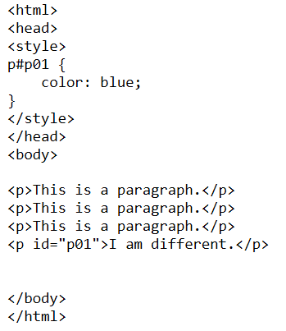
The id Attribute-Example

Slide 79

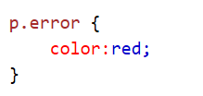
The class Attribute
To define a style for a special type (class) of elements, add a class attribute to the element:
Now you can define a different style for all elements with the specified class:

Slide 80
The class Attribute-Example
<html>
<head>
<style type="text/css">
. center
{
text-align:center;
}
</style>
</head>
<body>
<h1 class="center">Center-aligned heading</h1>
<p class="center">Center-aligned paragraph.</p>
</body>
</html>

Slide 81
The class Attribute
You can also specify that only specific HTML elements should be affected by a class.
In the next example, ONLY p elements with class="center" will be center-aligned:
<html>
<head>
<style type="text/css">
p. center
{
text-align:center;
}
</style>
</head>
<body>
<h1 class="center">The heading will not be affected</h1>
<p class="center">Center-aligned paragraph.</p>
</body>
</html>

Slide 82
CSS Multiple style sheets
External style sheet has these properties for the h3 selector:
h3 { color:red; text-align:left; font-size:8pt; }
Internal style sheet has these properties for the h3 selector:
h3 { text-align:right; font-size:20pt; }
color:red; text-align:right; font-size:20pt;

Slide 83
Multiple Styles Will Cascade into One
What style will be used when there is more than one style specified for an HTML element?
Generally speaking we can say that all the styles will "cascade" into a new "virtual" style sheet by the following rules, where number four has the highest priority:
Browser default
External style sheet
Internal style sheet (in the head section)
Inline style (inside an HTML element)
Notes:
Css margins and padding: https://blog.hubspot.com/website/css-margin-vs-padding
Css layout: https://developer.mozilla.org/en-US/docs/Learn/CSS/CSS_layout/Introduction

Slide 84
ANY QUESTIONS?

Slide 85
THANK YOU

